Slide 1


GoldenAuctions
Laboratory of Advanced Programming
Federico Ambrogio 1810535
Luigi Buccigrossi
1793929
Francesco Fè 1814878
Angelo Casciani - 2022406
Marco De Luca - 2017104
1
A.Y. 2023/2024

Slide 2
Brief presentation
GoldenAuctions is a web platform through which users can take part in an auction or create one of their own.
The customers should be able to:
Access to main page, in which trending auctions are available.
Search for a specific auction.
Participate to an auction.
Create their own auction.
Register and access with its credentials.
Access to the page containing their active auctions.
Access to the page containing the auctions in which they are participating.
Update their credentials.
Logout from the Application.

Slide 3
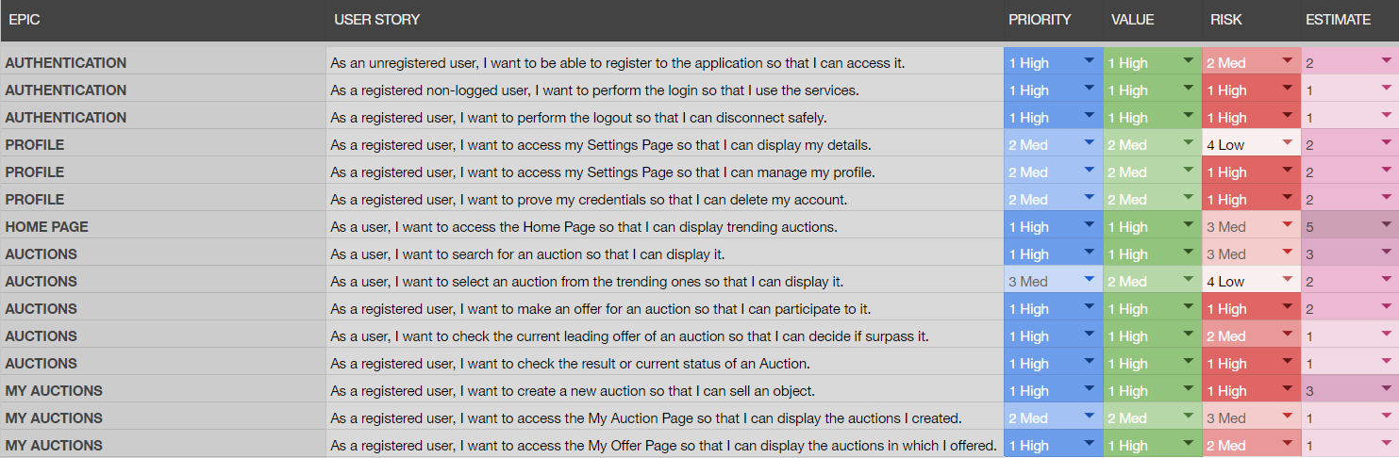
User stories

Slide 4
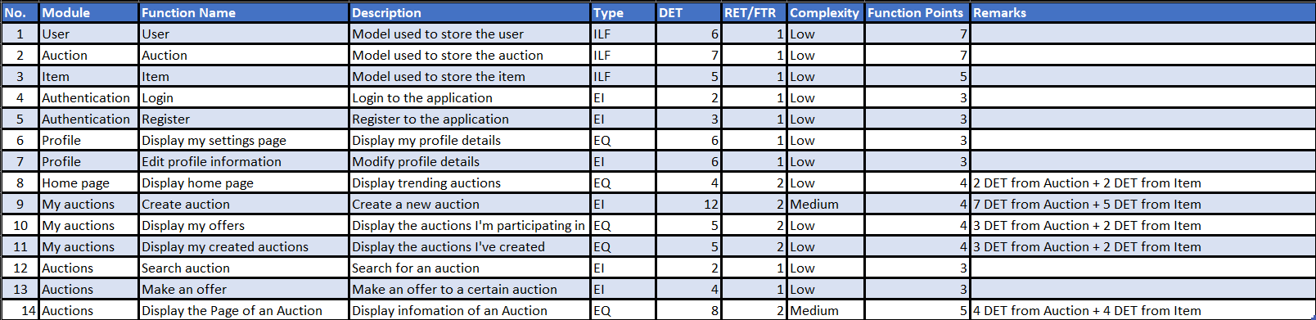
Function points
Function Points = 58
Estimated SLOC = 3074
Real SLOC = 4812
7.5 Person-Months
6.9 Months

Slide 5
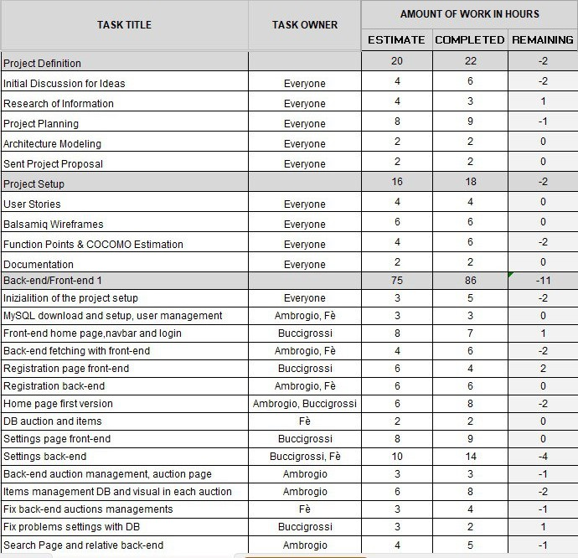
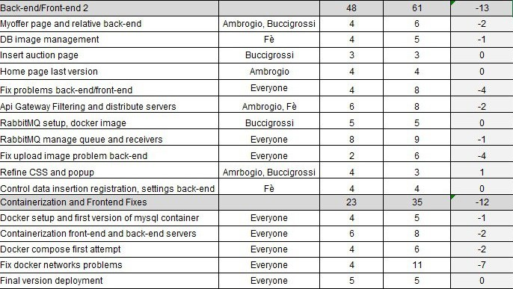
Scrum Sprint Planning
5 Sprints
60 Days
3.03 Avg Estimated Hours per Day
182 Estimated Hours
222 Total Hours

Slide 6
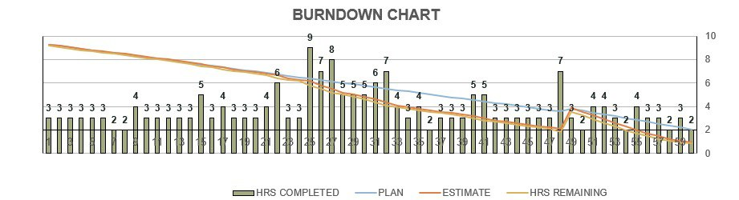
Burndown Chart

Slide 7
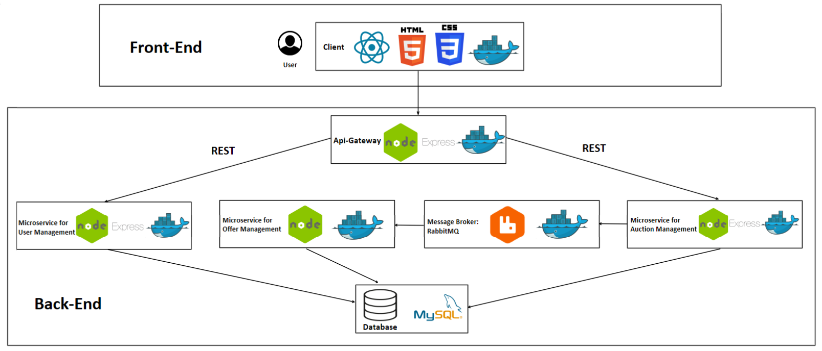
System Architecture

Slide 8




Front-End
Front-End is the component that displays and manages the interaction of the Application on Client side.

Slide 9


Api-Gateway
The Api-Gateway is the component that is in charge of orchestrating Microservices.
It contacts the two Microservices dealing with User and Auction Management.

Slide 10
Microservice for User Management
This is the Microservice that manages all the tasks related to the Accounting, like login, register and settings.

Slide 11

Microservice for Auction Management
With this Microservice is possible to manage the Auctions. Indeed with it we can initialize a new Auction or accede to the data of an already existing one.
It uses RabbitMQ to communicate with the Microservice for Offer Management.

Slide 12
Microservice for Offer Management
The Offer Management Microservice deals with users that surpass an offer in an Auction. It receives the communication of the offer form a Queue managed by RabbitMQ.
Each Category of the Objects has a relative Queue, that sends messages to two Workers using a Round-Robin Algorithm.

Slide 13

Database
Our Database is MySql DB, that stores data about Users, Auctions, and Items that are put up for Auction.
Most of our Microservices communicate with it, to create, modify or retrieve cells of the Tables.

Slide 14
Now let’s have a look to the Application.

